Slide 1

WEB TECHNOLOGIES
HTML - Basic Markups
Revathi G P
Department of
Computer Science and Engineering

Slide 2

HTML – Basic Markups
Basic Syntax
HTML is used to create the structure of web pages that are displayed on the World Wide Web (www).
It contains Tags and Attributes that are used to design the web pages. Also, we can link multiple pages using Hyperlinks.
HTML stands for Hypertext Markup Language.
HTML is used to create web pages and web applications.
HTML is widely used language on the web.
We can create a static website by HTML only.
Technically, HTML is a Markup language rather than a programming language.

Slide 3
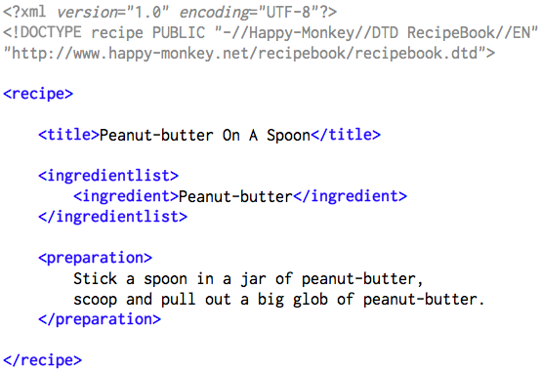
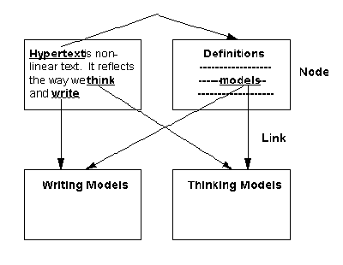
HTML – Basic Markups
Introduction
HTML – Hyper Text Markup Language
Hypertext - cross-referencing /linking between related sections of text and associated graphic material
Markup - define elements within a document using tags

Slide 4
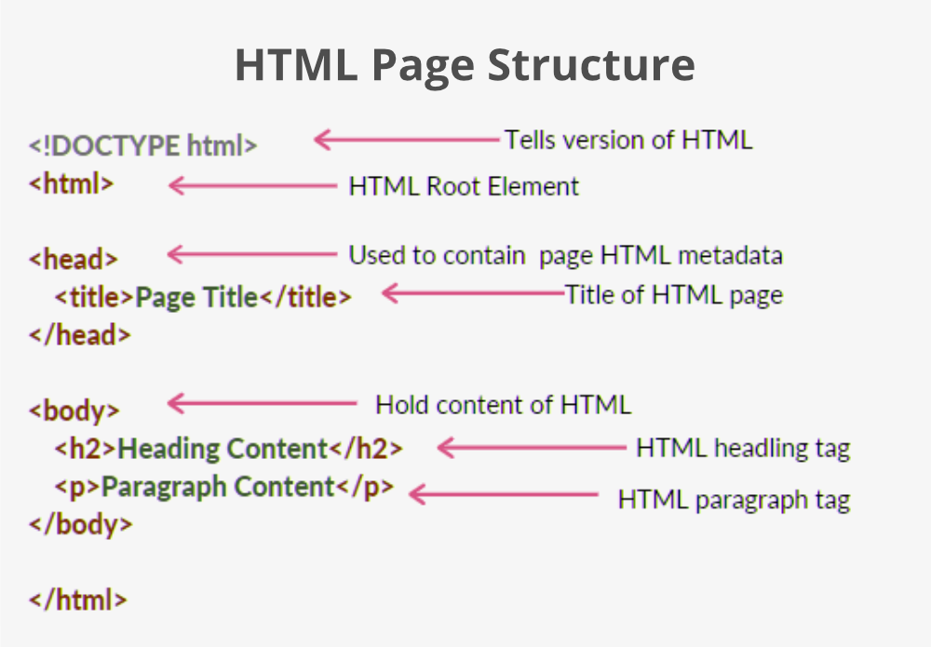
HTML – Basic Markups
Basic Syntax
An HTML document is made of many HTML tags and each HTML tag contains different content.
<html>
<head>
<title>
</body>

Slide 5
HTML – Basic Markups
HTML Tags
HTML tags contain three main parts: opening tag, content and closing tag. But some HTML tags are unclosed tags.
HTML tags are used to create HTML documents and render their properties. Each HTML tags have different properties.
Essential Tags
Can use as many tags you want as per your code requirement.

Slide 6
HTML – Basic Markups
HTML Tags
All HTML tags must enclosed within < > these brackets.
Every tag in HTML perform different tasks.
If you have used an open tag <tag>, then you must use a close tag </tag> (except some tags)
Syntax:
<tag>content</tag>

Slide 7
HTML – Basic Markups
Basic Syntax
Elements are defined by tags (markers)
Tag format:
Opening tag: <tag_name>
Closing tag: </tag_name>
Syntax:
<tag_name>
Content…
</tag_name>
Not all tags have content
If a tag has no content, its form is <tag_name … />
The container and its content together are called an element

Slide 8
HTML – Basic Markups
Basic Tags
<html> : Every HTML code must be enclosed between basic HTML tags. It begins with <html> and ends with </html> tag
<head>: The head tag comes next which contains all the header information of the web page or documents like the title of the page and other miscellaneous information.
<title>: We can mention the title of a web page using the <title> tag. This is header information and hence is mentioned within the header tags. The tag begins with <title> and ends with </title>
<body>: Next step is the most important of all the tags we have learned so far. The body tag contains the actual body of the page which will be visible to all the users. This opens with <body> and ends with </body>.

Slide 9
HTML – Basic Markups
Document Structure
<html>
<head>
<title>… </title>
</head>
<body>
…
</body>
</html>

Slide 10
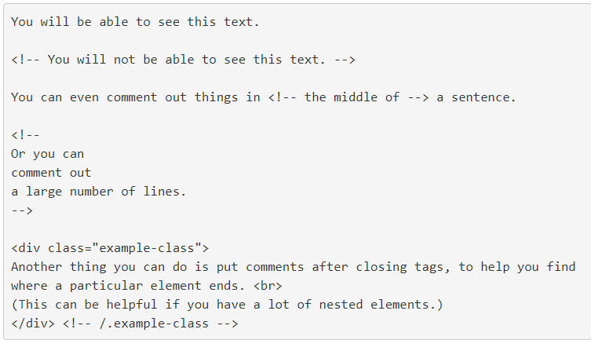
HTML – Basic Markups
Comments
An HTML comment begins with <! – – and the comment closes with – –>.
HTML comments are visible to anyone that views the page source code, but are not rendered when the HTML document is rendered by a browser.

Slide 11
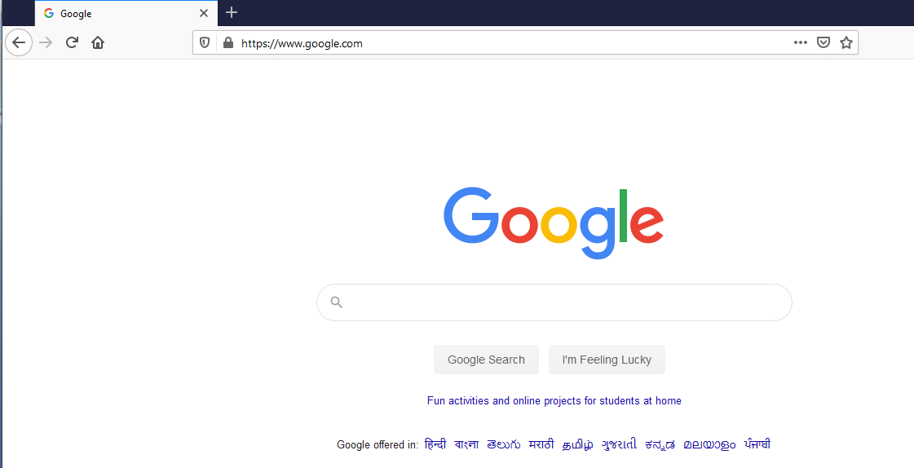
HTML – Basic Markups
Document Structure
title
body

Slide 12
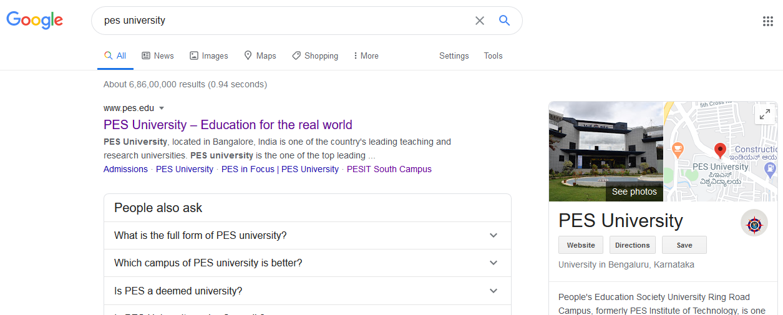
HTML – Basic Markups
Common Tags / Elements
Images
Paragraph
Headings
Links

Slide 13
HTML – Basic Markups
Common Tags / Elements
Text Content
Paragraphs
Headings
Lists
Tables
Images
Links

Slide 14
HTML – Basic Markups
Basic Tags
Heading Tags
<h1> </h1>
<h2> </h2>
<h3> </h3>
<h4> </h4>
<h5> </h5>
<h6> </h6>

Slide 15
HTML – Basic Markups
Basic Tags
Paragraph Tag
The <p> tag offers a way to structure your text into different paragraphs. Each paragraph of text should go in between an opening <p> and a closing </p>
Line Break Tag
<br>->to break paragraph to next line
<center> tag to put any content in the center of the page
The <hr> tag creates a line from the current position in the document to the right margin and breaks the line accordingly.

Slide 16
HTML – Basic Markups
Formatting tags
Example:
<!DOCTYPE>
<html>
<head>
<Web_page>
</head>
<body>
<p> My first web page </p>
</body>
</html>

Slide 17
HTML – Basic Markups
Basic Tags
HTML - Formatting
<b>...</b>----→bold
<i>...</i>---→italic
<u>...</u>-→underline
<strike>...</strike>
<sup>...</sup> -→superscript
<sub>…</sub>→subscript
<big>….</big>
<small>….</small>
<mark>…..</mark>
<strong>….</strong>

Slide 18
HTML – Basic Markups
Formatting tags
Example:
<!DOCTYPE>
<html>
<body>
<p> Paragraph Tag </p>
<h2> Heading Tag </h2>
<b> Bold Tag </b>
<i> Italic Tag </i>
<u> Underline Tag</u>
</body>
</html>

Slide 19
HTML – Basic Markups
Basic Tags
Unclosed HTML Tags
Some HTML tags are not closed, for example br and hr.
<br> Tag: br stands for break line, it breaks the line of the code.
<hr> Tag: hr stands for Horizontal Rule. This tag is used to put a line across the webpage.
Void element: All the elements in HTML do not require to have start tag and end tag, some elements does not have content and end tag such elements are known as Void elements or empty elements. These elements are also called as unpaired tag.

Slide 20
HTML – Basic Markups
Formatting tags
Example:
<!DOCTYPE>
<html>
<head>
<Web_page>
</head>
<body>
<p> My first web page <br>
Welcome to web page<hr>
Welcome to Webtech
</p>
</body>
</html>

Slide 21
HTML – Basic Markups
HTML Attribute
HTML attributes are special words which provide additional information about the elements or attributes are the modifier of the HTML element.
Each element or tag can have attributes, which defines the behavior of that element.
Attributes should always be applied with start tag.
The Attribute should always be applied with its name and value pair.
The Attributes name and values are case sensitive, and it is recommended by W3C that it should be written in Lowercase only.

Slide 22
HTML – Basic Markups
Attribute:href
Synatax
<element attribute_name="value">content</element>
<a>
<href>
The href attribute is the main attribute of <a> anchor tag.
This attribute gives the link address which is specified in that link.
The href attribute provides the hyperlink, and if it is blank, then it will remain in same page.
<a href="https://www.flipkart.com/html-anchor">This is a link</a>

Slide 23
HTML – Basic Markups
Hypertext Links
Hypertext is the essence of the Web!
A link is specified with the href attribute of <a> (the anchor tag)
The content of <a> is the visual link in the document
If the target is a whole document (not the one in which the link appears), the target need not be specified in the target document as being the target
Note: Relative addressing of targets is easier to maintain and more portable than absolute addressing

Slide 24
HTML – Basic Markups
Images
GIF (Graphic Interchange Format) =8-bit color (256 different colors)
JPEG (Joint Photographic Experts Group) =24-bit color (16 million different colors)
Portable Network Graphics (PNG)
Images are inserted into a document with the <img /> tag with the src attribute
The alt attribute is required by XHTML
<img src = "comets.jpg" alt = "Picture of comets" />
The <img> tag has 30 different attributes, including width and height (in pixels)

Slide 25
HTML – Basic Markups
src attribute
The src attribute is one of the important and required attribute of <img> element.
It is source for the image which is required to display on browser. This attribute can contain image in same directory or another directory.
The image name or source should be correct else browser will not display the image.
<img src="whitepeacock.jpg" height="400" width="600">

Slide 26
HTML – Basic Markups
Images…(cntd.)
<html>
<head> <title> Images </title>
</head>
<body>
<p>
<img src = "c210new.jpg" alt = "Picture of a Cessna 210"/>
<br />
Buy this fine airplane today at a
remarkably low price <br />
Call 999-555-1111 today!
</p>
</body>
</html>

Slide 27
HTML – Basic Markups
Hypertext links…(cntd.)
Example:
<html>
<head> <title> Links </title> </head>
<body>
…
<h2> Special of the month </h2>
<p> 1960 Cessna 210 <br />
<a href = "C210data.html"> Information on the Cessna 210 </a>
</p>
</body>
</html>

Slide 28
HTML – Basic Markups
Special Characters
Character Entities:
Char. Entity Meaning
& &amp; Ampersand
< &lt; Less than
> &gt; Greater than
” &quot; Double quote
’ &apos; Single quote
(space) &nbsp; Non-breaking space
Horizontal rules:
<hr /> draws a line across the display, after a line break

Slide 29
HTML – Basic Markups
Formatting tags
HTML Meta Tags: DOCTYPE, title, link, meta and style.
HTML Text Tags:<p>, <h1>, <h2>, <h3>, <h4>, <h5>, <h6>, <strong>, <em>, <abbr>, <acronym>, <address>, <bdo>, <blockquote>, <cite>, <q>, <code>, <ins>, <del>, <dfn>, <kbd>, <pre>, <samp>, <var> and <br>

Slide 30
HTML – Basic Markups
Lists
Used to present list of information in well formed and semantic way.
Three types of Lists:
Unordered list
Ordered list
Definition List

Slide 31
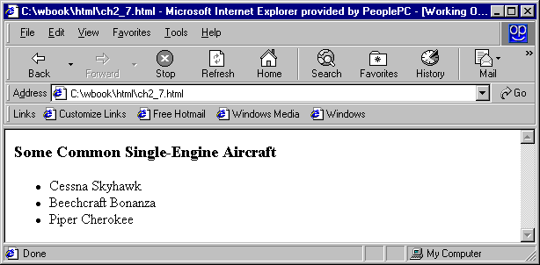
HTML – Basic Markups
Unordered Lists
The list is the content of the <ul> tag
List elements are the content of the <li> tag
<h3> Some Common Single-Engine Aircraft </h3>
<ul>
<li> Cessna Skyhawk </li>
<li> Beechcraft Bonanza </li>
<li> Piper Cherokee </li>
</ul>

Slide 32
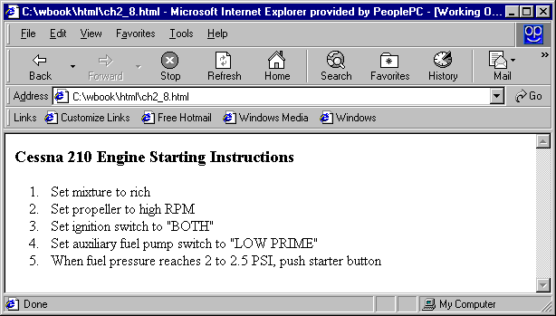
HTML – Basic Markups
Ordered Lists
The list is the content of the <ol> tag
Each item in the display is preceded by a sequence value
<h3> Cessna 210 Engine Starting Instructions</h3>
<ol>
<li> Set mixture to rich </li>
<li> Set propeller to high RPM </li>
<li> Set ignition switch to "BOTH" </li>
<li> Set auxiliary fuel pump switch to
"LOW PRIME" </li>
<li> When fuel pressure reaches 2 to 2.5
PSI, push starter button </li>
</ol>

Slide 33
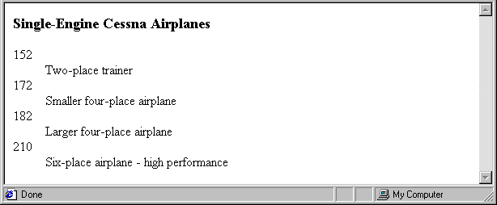
HTML – Basic Markups
Definition Lists
List is the content of the <dl> tag
Terms being defined are the content of the <dt> tag
The definitions themselves are the content of the <dd> tag
<h3> Single-Engine Cessna Airplanes </h3>
<dl >
<dt> 152 </dt>
<dd> Two-place trainer </dd>
<dt> 172 </dt>
<dd> Smaller four-place airplane </dd>
</dl>

Slide 34
HTML – Basic Markups
Tables
A matrix of cells, each possibly having content
The cells can include almost any element
Some cells have row or column labels and some have data
A table is specified as the content of a <table> tag
A border attribute in the <table> tag specifies a border between the cells
Tables are given titles with the <caption> tag, which can immediately follow <table>

Slide 35
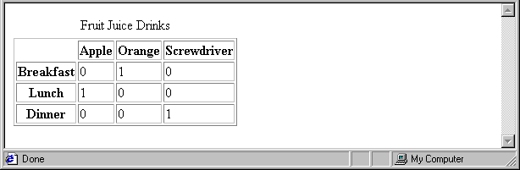
HTML – Basic Markups
Tables…(cntd.)
Each row of a table is specified as the content of a <tr> tag
The row headings are specified as the content of a <th> tag
The contents of a data cell is specified as the content of a <td> tag.
<table border = "border">
<caption> Fruit Juice Drinks </caption>
<tr>
<th> </th>
<th> Apple </th>
<th> Orange </th>
<th> Screwdriver </th>
</tr>
<tr>
<th> Breakfast </th>
<td> 0 </td>
<td> 1 </td>
<td> 0 </td>
</tr>
</table>

Slide 36
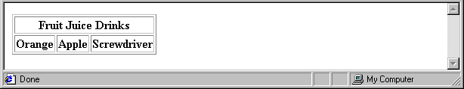
HTML – Basic Markups
Tables : Column Span
<tr>
<th colspan = "3"> Fruit Juice Drinks </th>
</tr>
<tr>
<th> Orange </th>
<th> Apple </th>
<th> Screwdriver </th>
</tr>

Slide 37
HTML – Basic Markups
Tables : Row Span
If the rows have labels and there is a spanning column label, the upper left corner must be made larger, using rowspan
<table border = "border">
<tr>
<td rowspan = "2"> </td>
<th colspan = "3"> Fruit Juice Drinks
</th>
</tr>
<tr>
<th> Apple </th>
<th> Orange </th>
</tr>
…
</table>

Slide 38
HTML – Basic Markups
Tables : Column Span

Slide 39
HTML – Basic Markups
Tables : Column Span

Slide 40
THANK YOU
Vinay Joshi
Department of Computer Science and Engineering
vinayj@pes.edu
+91 80 2672 6622

